Slide 1
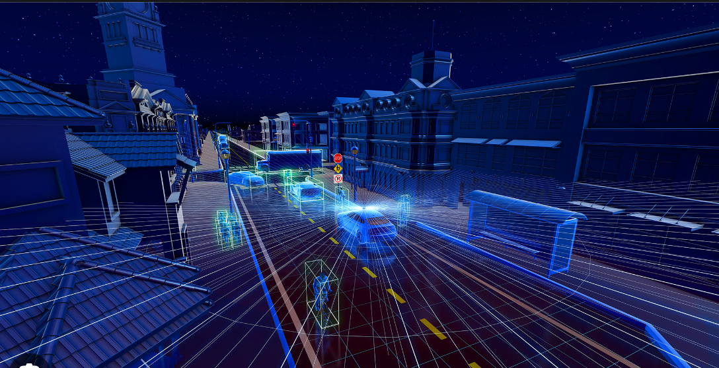
LICENSE PLATE DETECTION
USER MANUAL
Author: Caroline David

Slide 2

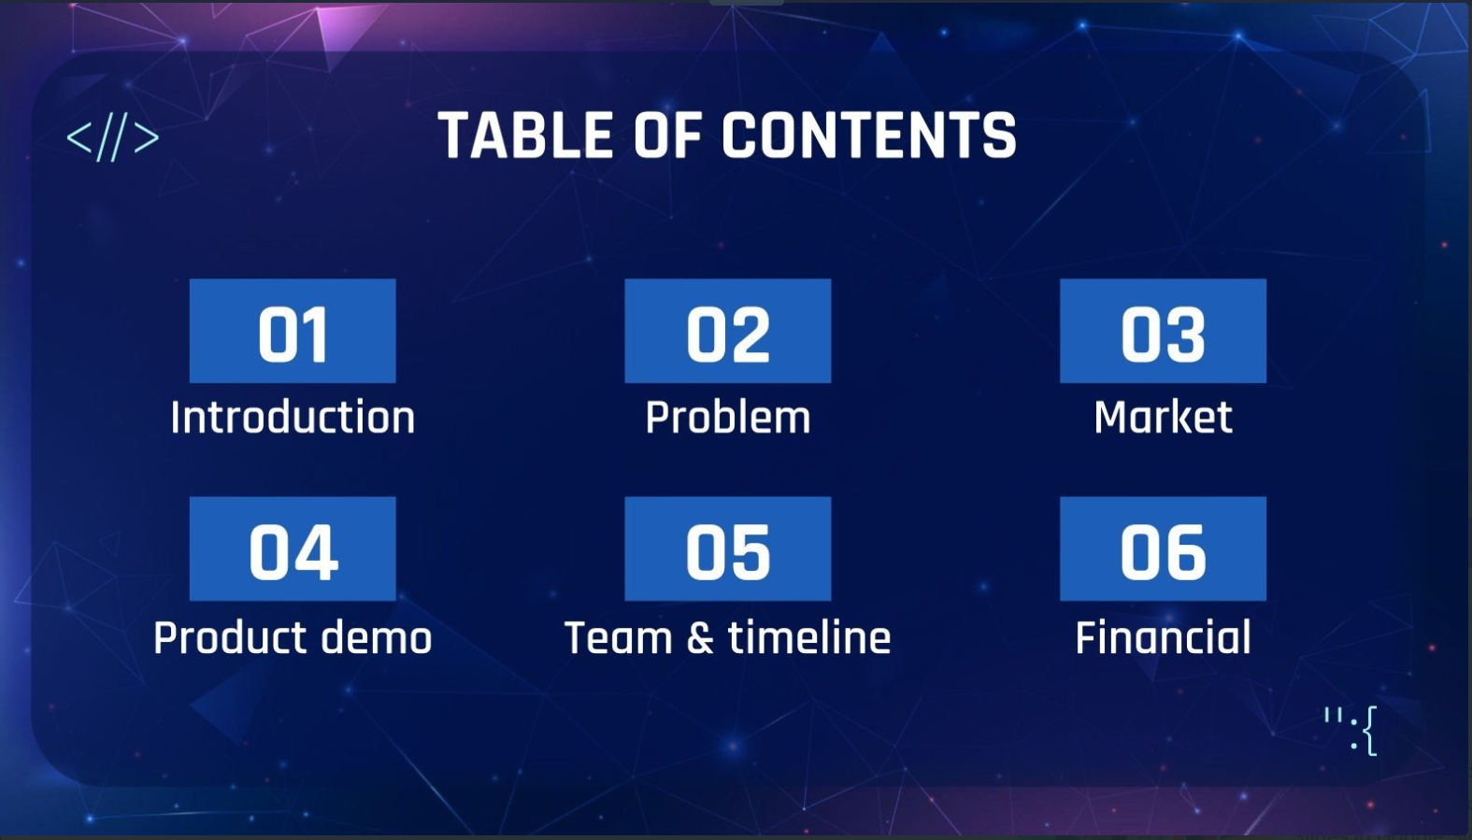
ACKNOWLEDGMENTS
ABOUT ME
ABOUT APP
HOW TO USE THE APP
TOOLKIT WALKTHROUGH
CONTACT PERSON

Slide 3
ACKNOWLEDGEMENTS
A small vote of thanks for all who have helped me throughout this journey ,my parents, Mr. Ken, Clevered, Mentors and Sites.

Slide 4
ABOUT ME
I am Caroline David, a 12th grade student at The Cambridge School. I reside in Qatar and have a keen interest in reading books and playing the piano.

Slide 5
About My Internship Journey with Clevered
My experience during my internship at Clevered has been truly fantastic and has imparted me with valuable knowledge beyond what I had acquired previously. I've not only enhanced my coding abilities but also grown more self-assured in my programming skills.

Slide 6
ABOUT APP
This app is License Plate Recognizer, which cross-references the license plate number to national and/or international databases, captures a video image of a license plate and then uses an optical character recognition (OCR) algorithm to convert the plate number to the ASCII character set.
This app can be used by police forces around the world for law enforcement purposes, including checking if a vehicle is registered or licensed. Automatic number-plate recognition can be used to store the images captured by the cameras as well as the text from the license plate.

Slide 7
HOW DO I USE THE APP?

Slide 8
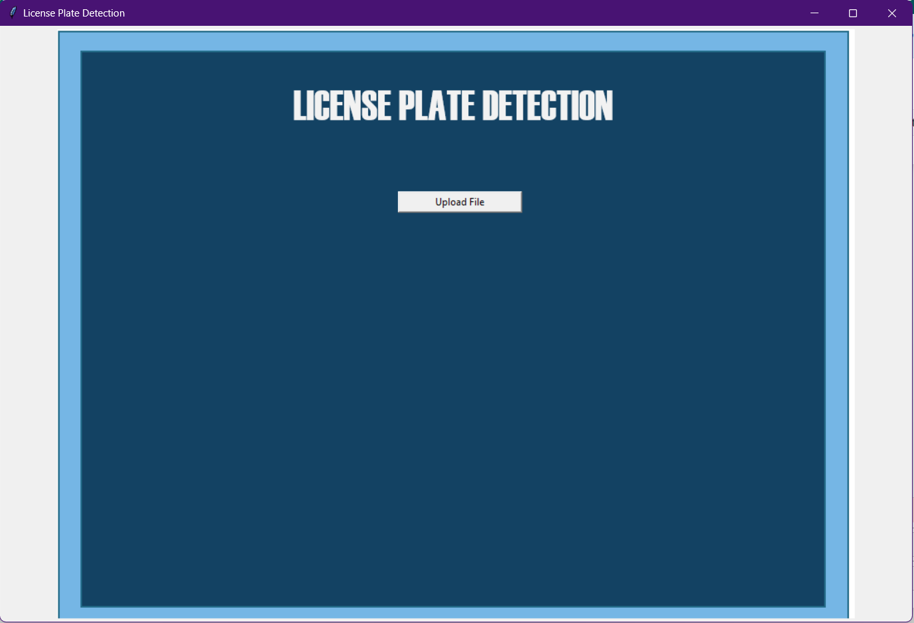
We can start by pressing on this button to insert the image you wish to detect

Slide 9
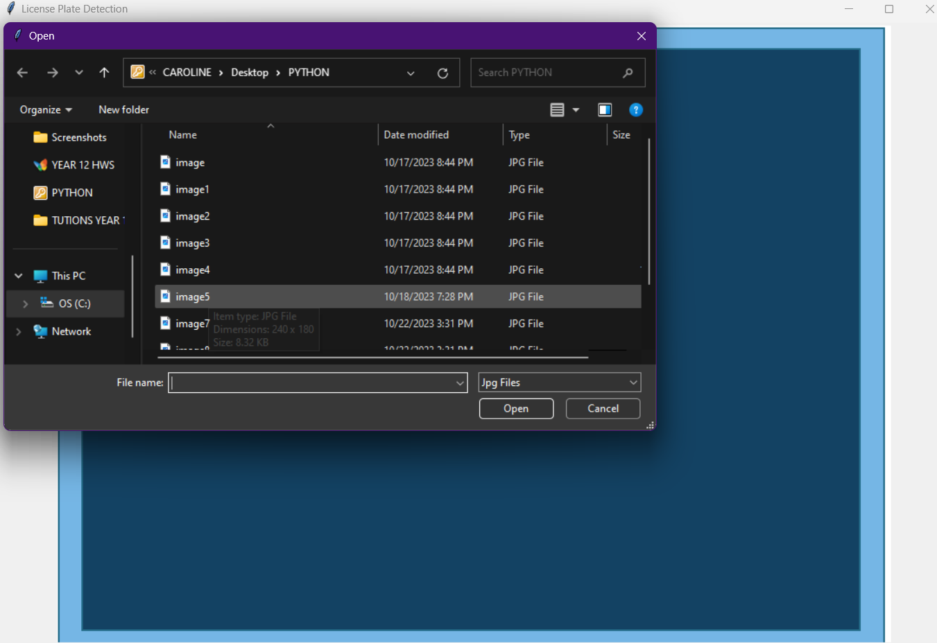
Then u can choose the image which you wish to scan .

Slide 10
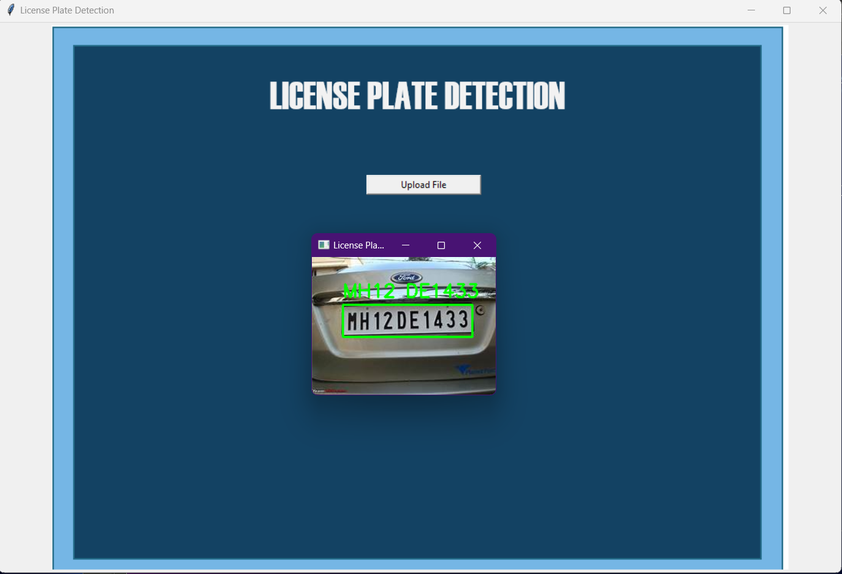
After doing so you will get your output .

Slide 11
TOOLKIT WALKTHROUGH

Slide 12
CONTACT PERSON
Please reach out to me at :
caroline.david135006@gmail.com for any questions/ concerns/ suggestions on the App.

